Slide 1
Bitcoin blockchain visualization
Instructor : Ivan pustogarov
Course : Cybercrime Investigations
Date : 09/08/2023

Slide 2
INTRODUCTION
The rise of Bitcoin, as the first decentralized digital currency, has revolutionized the world of finance and introduced the concept of blockchain technology, a distributed and immutable ledger.
The Bitcoin blockchain, a chain of blocks containing transaction data, plays a pivotal role in ensuring transparency, security, and trust in the network.
As the blockchain grows in size and complexity, visualizing its structure becomes crucial for understanding its intricate relationships and patterns.
Visual representation of the Bitcoin blockchain graph can provide valuable insights into the dynamics of transactions, addresses, and the overall network.
This visualization enables users to grasp the decentralized nature of the blockchain, revealing how it operates without a central authority.
examining the connections between transactions and addresses enables the identification potential money laundering, illicit activities, and other suspicious behavior.

Slide 3
INTRODUCTION
Understanding the significance of the Bitcoin blockchain graph can help researchers, analysts, and policymakers in developing better regulatory frameworks and combating financial crimes.
The visualization also aids in analyzing transactional flows, identifying market trends, and assessing the health of the Bitcoin ecosystem.
Furthermore, it allows stakeholders to monitor the concentration of wealth and the distribution of coins among addresses, addressing concerns of wealth inequality.
Real-time visualization of the Bitcoin blockchain graph can provide invaluable data for investors, enabling them to make informed decisions.
As cryptocurrencies gain traction, understanding blockchain graphs becomes vital not just for Bitcoin but also for other blockchain-based systems.

Slide 4
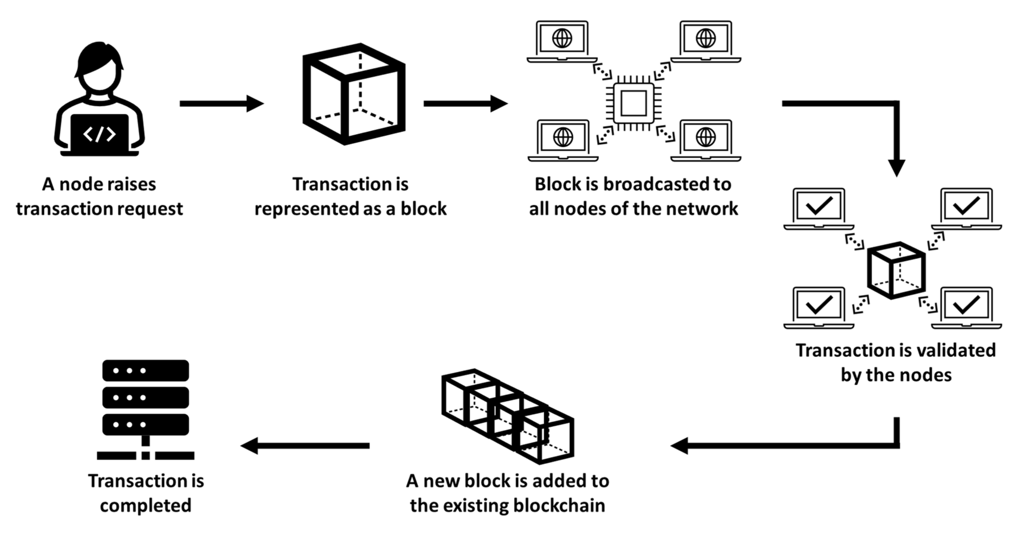

Slide 5
OBJECTIVES
An in-depth background into the foundational concepts of Bitcoin and blockchain technology.
Showcasing the relevance of visualizing this data.
Exploring visualization techniques.
Analyzing real-world use applications.
Discussing the associated challenges and future trajectories.

Slide 6


Slide 7
PURPOSE
A . Enhanced data navigation – Visual representation of any data format enables users to explore vast amounts of data in a more interactive and accessible manner. Researchers and analysts can zoom in on specific time frames and address clusters leading to a deeper understanding of the network's behavior.
B. Detection of Patterns and Anomalies – Such visualization is essential in detecting, identifying, and analyzing patterns and anomalies which are not always visible and apparent in the tabular data. It can reveal clusters of related addresses, transaction flows, and potential irregularities.
C . Network Security and Performance Analysis- Visualizing the blockchain graph makes it much easier to assess and appraise key network components, such as the affiliated and potential vulnerabilities, and analyze its overall performance. This information is vital for enhancing the block chain’s efficiency and security against attacks.
D . Policy Formulation and Regulatory Compliance – This topic is of essence to governments and regulatory bodies as they can analyze the associated metrics, such as its usage, and identify trends related to money laundering, tax evasion, and other illicit activities.

Slide 8
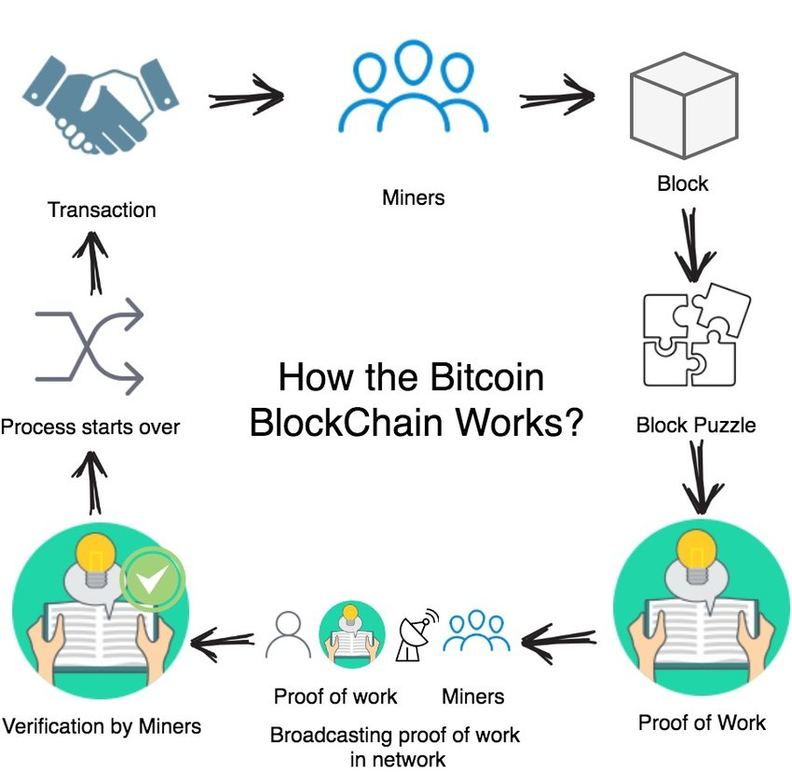

Slide 9
REVIEW OF LITERATURE
Blockchain technology is transformative and decentralized, revolutionizing various industries.
Visualization tools are crucial to comprehend complex relationships in blockchain networks.
Early blockchain visualizations were limited, primarily displaying transaction sequences.
Advanced techniques like node-link diagrams, hierarchical visualizations, and heatmaps have emerged.
Challenges in visualization include handling large datasets, real-time updates, privacy concerns, misuse, and scalability.
In finance, it aids in tracking fund flow, market trends, and portfolio management.
Supply chain management benefits from traceability and authenticity verification of products.
Healthcare uses visualization for secure medical records and clinical trials monitoring.
Graph visualization techniques like force-directed layouts and hierarchical layouts are used in blockchain visualization.

Slide 10
REVIEW OF LITERATURE (cont.)
Bitcoin blockchain visualization is used to monitor transactions and market sentiment.
It enhances risk assessment, portfolio management, and liquidity analysis.
Supply chain management in Bitcoin benefits from transparency and traceability.
Visualization aids in tracking product authenticity and reducing counterfeiting risks.
Healthcare leverages blockchain visualization for secure medical records and clinical trials.
Blockchain visualization tools help researchers, regulatory bodies, and participants access and verify clinical trial data.
Blockchain visualization enhances transparency in governmental processes.
Citizens can see how tax dollars are spent and hold officials accountable.

Slide 11
REVIEW OF LITERATURE (cont.)
Matrix-based representations, like adjacency matrices, are used for dense blockchain networks.
Challenges in visualization include handling large datasets and ensuring real-time updates.
Privacy concerns arise due to the public nature of the Bitcoin blockchain.
Misuse of Bitcoin involves potential illegal activities and scams.
Scalability is a significant concern in the evolution of the Bitcoin blockchain.
Increasing data volumes cause transaction backlogs and delayed confirmation times.
Proposed solutions include increasing block size and implementing second-layer networks like Lightning Network.
Blockchain visualization in finance tracks fund flow and market trends.
It aids in risk assessment, portfolio management, and detecting abnormal market behaviors.
Supply chain management benefits from blockchain's transparency and traceability.

Slide 12
REVIEW OF LITERATURE (cont.)
Visualization tools help monitor product authenticity and reduce counterfeiting risks.
Healthcare uses blockchain visualization for secure medical records and clinical trials monitoring.
Blockchain visualization enhances transparency in governmental processes.
Force-directed layouts simulate physical forces for balanced network representation.
Hierarchical layouts display nested relationships within the blockchain network.
Matrix-based representations like adjacency matrices are used for dense blockchain networks.
Visualization tools are vital for handling large datasets and ensuring real-time updates.
Privacy concerns arise due to the public nature of the Bitcoin blockchain.
Misuse of Bitcoin involves potential illegal activities and scams.
Scalability is a significant concern in the evolution of the Bitcoin blockchain. Increasing data volumes cause transaction backlogs and delayed confirmation times.

Slide 13


Slide 14
APPLICATION OF BITCOIN BLOCKCHAIN – Finance
Transparency and Traceability: Bitcoin's blockchain visualization provides financial institutions with real-time access to transparent and immutable transaction data. This allows for enhanced traceability of funds, enabling auditors and regulators to monitor financial activities more efficiently.
Fraud Detection and Prevention: The visualization of the Bitcoin blockchain aids in identifying patterns and anomalies that may indicate fraudulent activities.
Market Analysis and Risk Assessment: By analyzing the blockchain data, financial analysts can gain valuable insights into market trends, liquidity, and trading patterns
Customer Behavior Analysis: Blockchain visualization allows financial institutions to analyze customer behavior and preferences concerning cryptocurrency transactions. This knowledge can be used to tailor personalized services to better serve their clientele.
Transaction Speed and Cost Analysis: The ability to visualize the Bitcoin blockchain facilitates an understanding of transaction speed and associated costs.
Portfolio Management and Asset Tracking: Financial professionals can use blockchain visualization tools to monitor the movement of assets across various blockchain networks.

Slide 15
APPLICATION OF BITCOIN BLOCKCHAIN – HEALTHCARE
Enhanced Transparency: The application of Bitcoin blockchain visualization in healthcare allows for increased transparency in medical data management. Each medical transaction or record is documented as a block on the blockchain, providing a comprehensive and tamper-resistant history of patient information, treatments, and diagnoses.
Improved Data Security: Blockchain's decentralized nature ensures that medical data is securely stored and encrypted. With cryptographic techniques, patient data is protected from unauthorized access, reducing the risk of data breaches and identity theft.

Slide 16
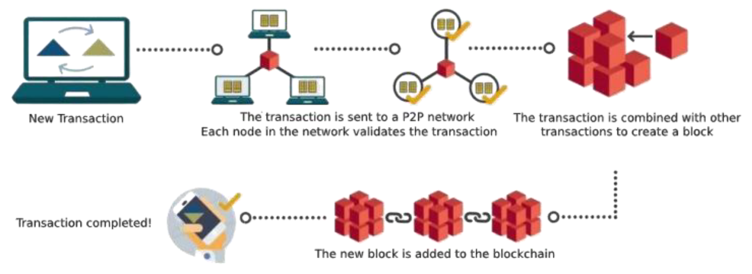

Slide 17
APPLICATION OF BITCOIN BLOCKCHAIN – SUPPLY CHAIN MANAGEMENT
Improved Traceability: With blockchain visualization, supply chain managers can trace the origin of raw materials and components used in the production process. This feature is particularly crucial in industries with strict compliance requirements or those dealing with sensitive products, such as pharmaceuticals or luxury goods.
Efficient Inventory Management: Bitcoin blockchain visualization can optimize inventory management by providing real-time data on the movement of goods. This allows supply chain managers to accurately track stock levels, anticipate demand fluctuations, and make data-driven decisions to avoid stock outs or excess inventory.
Supply Chain Auditing and Compliance: The immutable nature of blockchain records enables easy auditing of the supply chain. Regulatory compliance and quality assurance audits become more straightforward as all transactional data is securely recorded on the blockchain which streamlines the affiliated auditing processes.
Supply Chain Risk Management: Using blockchain visualization enables supply chain managers identify and assess potential risks across the supply chain. This includes analyzing the reliability of suppliers, monitoring external factors like geopolitical changes or natural disasters that could impact the supply chain

Slide 18
VISUALIZATION WITH ENHANCED DATA ATTRIBUTES
Enhanced Data Attributes: Visualization refers to the graphical representation of data to facilitate understanding and insights. When using enhanced data attributes in visualizations, additional relevant information is incorporated to provide a more comprehensive view of the data.
Interactive Elements: Visualizations with enhanced data attributes often include interactive elements such as tooltips, filters, and zoom features. These interactions empower users to drill down into specific data points or subsets, fostering a deeper understanding of the underlying information.
Real-time Data Integration: By leveraging enhanced data attributes, visualizations can incorporate real-time data updates, making them dynamic and adaptive. This is particularly beneficial for time-sensitive analyses and tracking rapidly changing trends.
Contextual Information: Enhanced data attributes in visualizations allow the inclusion of contextual information like metadata, annotations, and labels. This contextualization helps users interpret the data accurately and draws attention to critical insights.

Slide 19
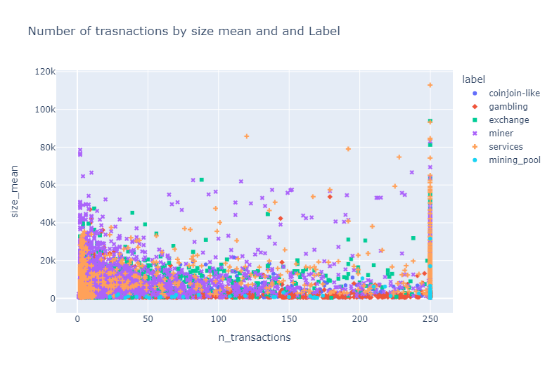
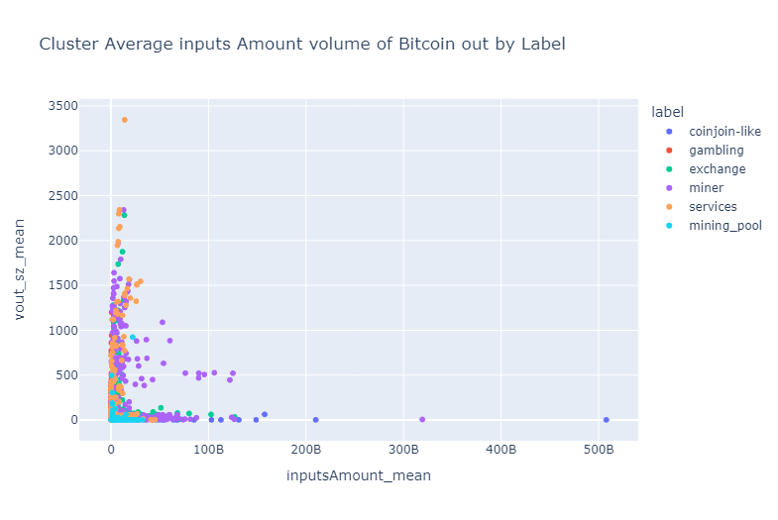
Visualizing visual transactions by address type

Slide 20
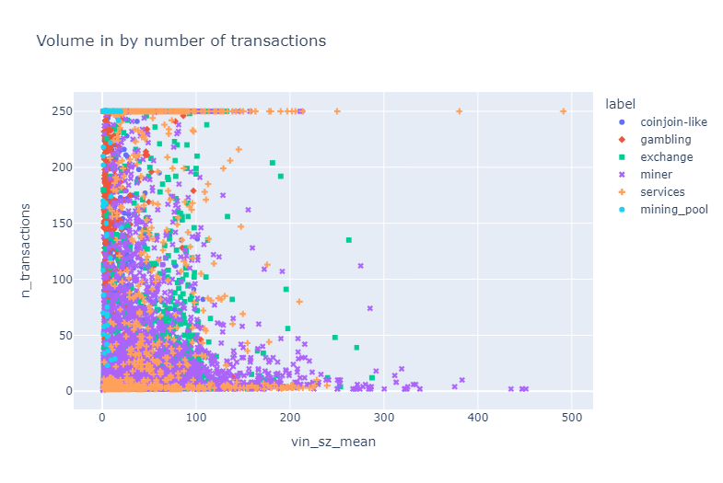
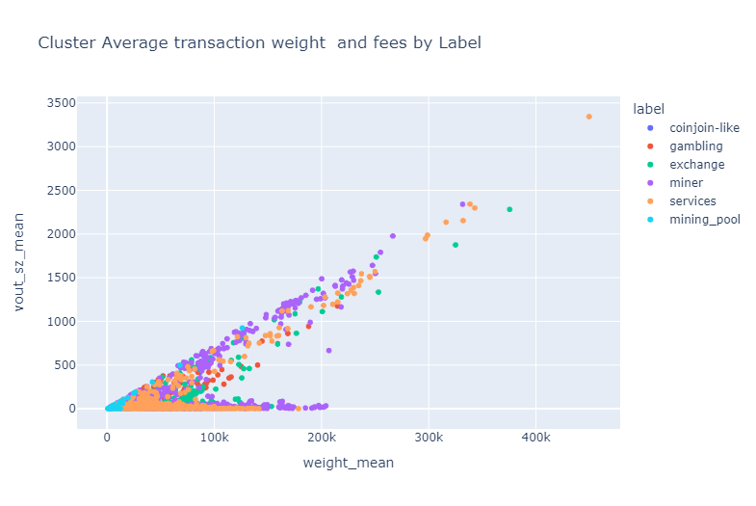
Volume in by number of transactions

Slide 21
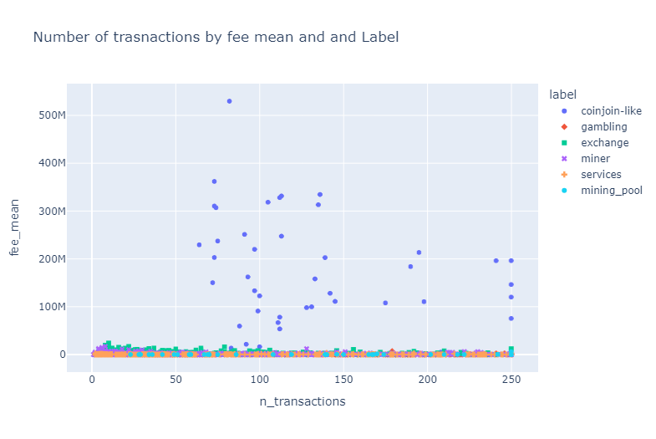
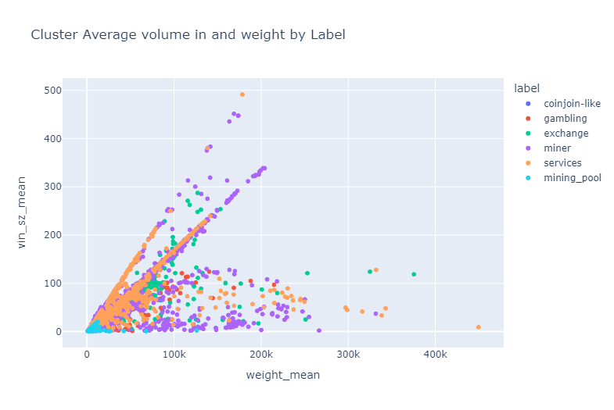
Visualizing number of transactions by average fee and label

Slide 22
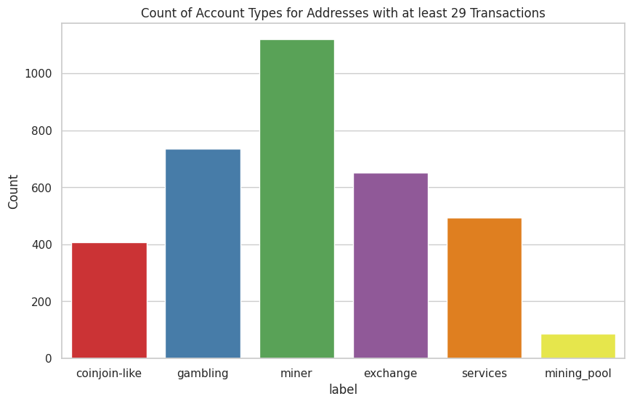
Notes:
The number of transactions based on the type of address has been visualized interactively in the attached notebook. Using the slider will continuously indicate the changing trends in the different clusters of accounts as the number of transactions increases.

Slide 23
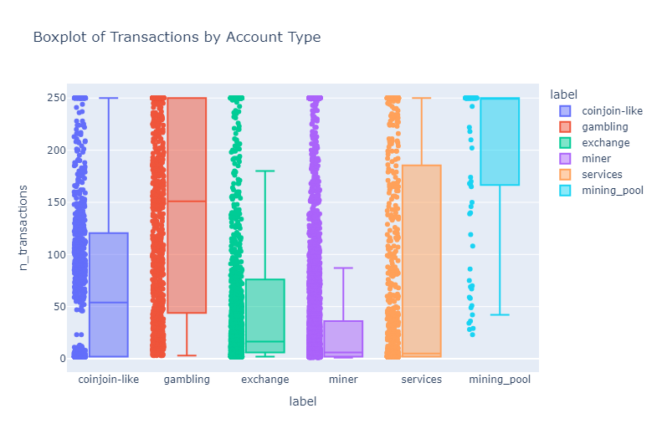
Boxplot

Slide 24
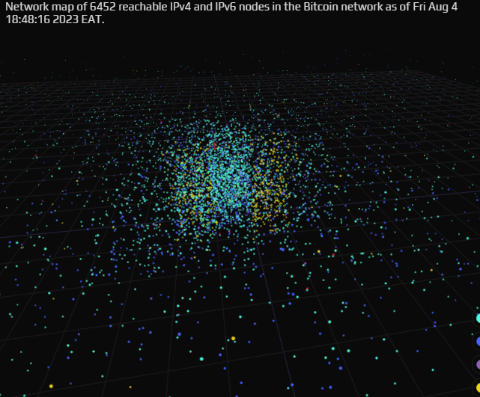
Bitcoin Network MAP of 6452 reachable nodes

Slide 25
References
Ahmed, M., Shumailov, I., & Anderson, R. (2019). Tendrils of crime: Visualizing the diffusion of stolen bitcoins. In Graphical Models for Security: 5th International Workshop, GraMSec 2018, Oxford, UK, July 8, 2018, Revised Selected Papers 5 (pp. 1-12). Springer International Publishing.
Akcora, C. G., Gel, Y. R., & Kantarcioglu, M. (2017). Blockchain: A graph primer. arXiv preprint arXiv:1708.08749.
Bao, D., Ren, W., Xiang, Y., Liu, W., Zhu, T., Ren, Y., & Choo, K. K. R. (2023). BTC-Shadow: an analysis and visualization system for exposing implicit behaviors in Bitcoin transaction graphs. Frontiers of Computer Science, 17(6), 1-3.
Di Battista, G., Di Donato, V., Patrignani, M., Pizzonia, M., Roselli, V., & Tamassia, R. (2015, October). Bitconeview: visualization of flows in the bitcoin transaction graph. In 2015 IEEE Symposium on Visualization for Cyber Security (VizSec) (pp. 1-8). IEEE.
Framewala, A., Harale, S., Khatal, S., Patel, D., Busnel, Y., & Rajarajan, M. (2020, April). Blockchain analysis tool for monitoring coin flow. In 2020 Seventh International Conference on Software Defined Systems (SDS) (pp. 196-201). IEEE.
Goldsmith, D., Grauer, K., & Shmalo, Y. (2020). Analyzing hack subnetworks in the bitcoin transaction graph. Applied Network Science, 5(1), 1-20.

Slide 26
References
Shah, R. S., Bhatia, A., Gandhi, A., & Mathur, S. (2021, January). Bitcoin data analytics: Scalable techniques for transaction clustering and embedding generation. In 2021 international conference on communication systems & NETworkS (COMSNETS) (pp. 1-6). IEEE.
Shin, H. Y., Kim, D., Maeng, S., Lee, K., & Ju, H. (2019, September). Web Server for Analysis and Visualization of Bitcoin Data. In 2019 20th Asia-Pacific Network Operations and Management Symposium (APNOMS) (pp. 1-3). IEEE.
Shrestha, A. K., & Vassileva, J. (2018, November). Bitcoin blockchain transactions visualization. In 2018 International Conference on Cloud Computing, Big Data and Blockchain (ICCBB) (pp. 1-6). IEEE.

